Slide 1
C++ Programming:
From Problem Analysis to Program Design, Fourth Edition
Chapter 10: Applications of Arrays (Searching and Sorting) and the vector Type

Slide 2
Objectives
In this chapter, you will:
Learn how to implement the sequential search algorithm
Explore how to sort an array using the bubble sort, selection sort, and insertion sort algorithms
Learn how to implement the binary search algorithm
Become familiar with the vector type
C++ Programming: From Problem Analysis to Program Design, Fourth Edition

Slide 3
List Processing
List: a set of values of the same type
Basic list operations:
  Search for a given item
  Sort the list
  Insert an item in the list
  Delete an item from the list
C++ Programming: From Problem Analysis to Program Design, Fourth Edition

Slide 4
Searching
To search a list, you need:
  The list (array) containing the list
  List length
  Item to be found
After the search is completed
  If found:
    Report “success”
    Location where the item was found
  If not found, report “failure”
C++ Programming: From Problem Analysis to Program Design, Fourth Edition

Slide 5
Sequential Search
Sequential search: search a list for an item
Compare search item with other elements until either:
  Item is found
  List has no more elements left
Average number of comparisons made by the sequential search equals half the list size
Good only for very short lists
C++ Programming: From Problem Analysis to Program Design, Fourth Edition

Slide 6
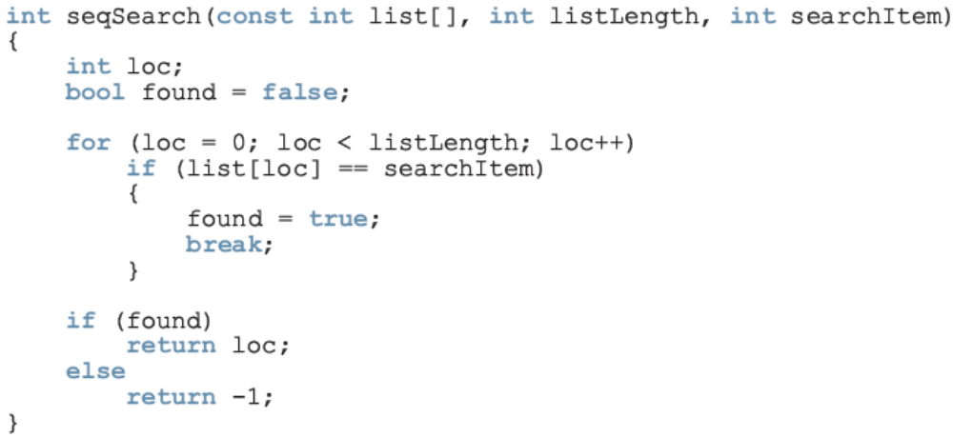
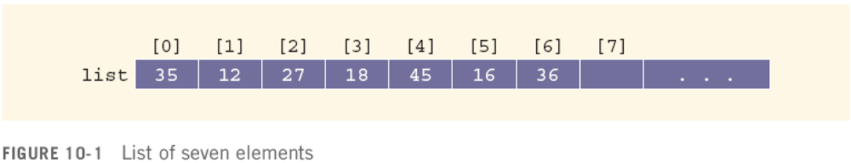
Sequential Search (continued)
C++ Programming: From Problem Analysis to Program Design, Fourth Edition

Slide 7
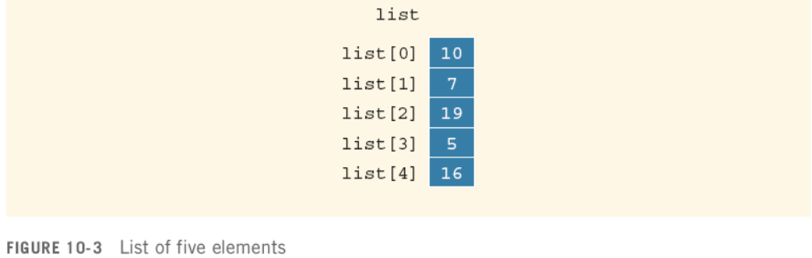
Bubble Sort
Suppose list is a list of n elements
In n-1 iterations compare elements list[index] and list[index + 1]
If list[index] > list[index + 1], then swap them
C++ Programming: From Problem Analysis to Program Design, Fourth Edition

Slide 8
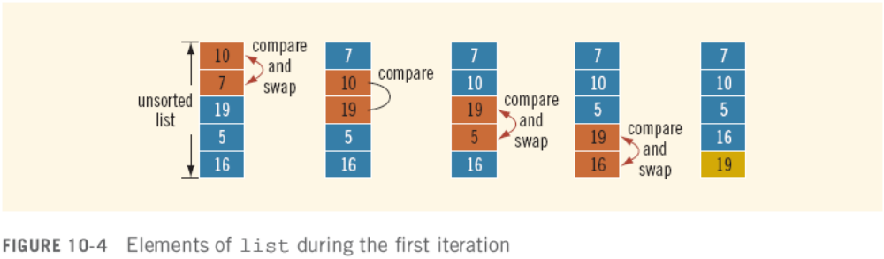
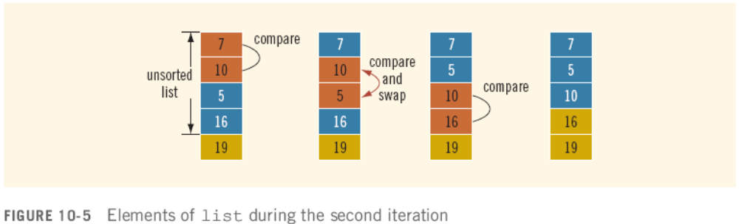
Bubble Sort (continued)
C++ Programming: From Problem Analysis to Program Design, Fourth Edition

Slide 9
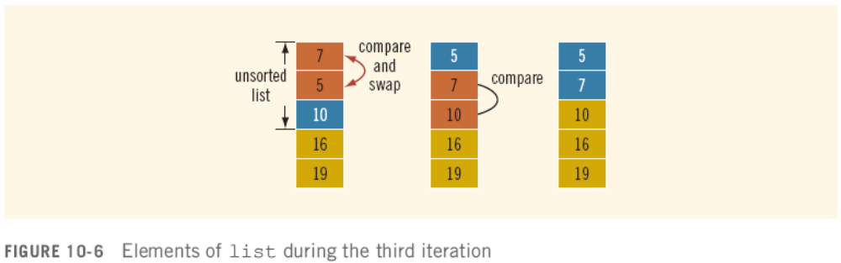
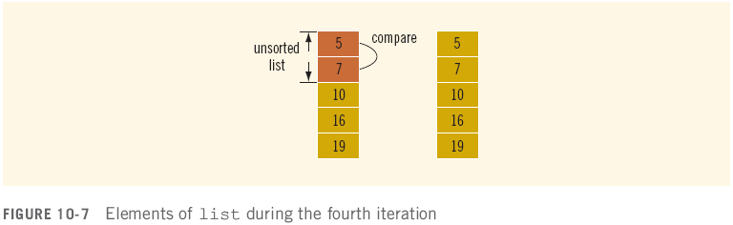
Bubble Sort (continued)
C++ Programming: From Problem Analysis to Program Design, Fourth Edition

Slide 10
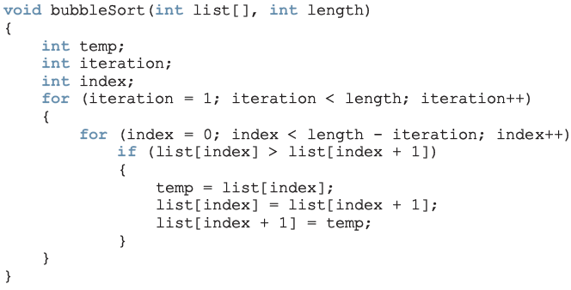
Bubble Sort (continued)
For a list of length n, on average, a bubble sort makes n(n–1)/2 key comparisons
C++ Programming: From Problem Analysis to Program Design, Fourth Edition

Slide 11
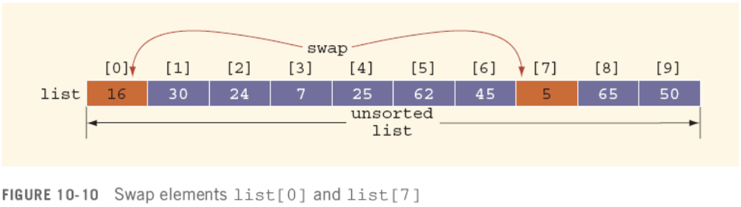
Selection Sort
Selection sort: rearrange list by selecting an element and moving it to its proper position
Find the smallest (or largest) element and move it to the beginning (end) of the list
C++ Programming: From Problem Analysis to Program Design, Fourth Edition

Slide 12
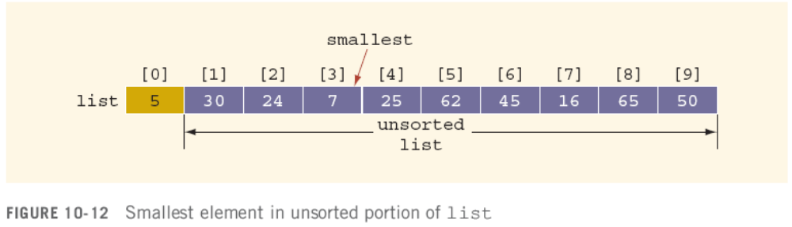
Selection Sort (continued)
On successive passes, locate the smallest item in the list starting from the next element
C++ Programming: From Problem Analysis to Program Design, Fourth Edition

Slide 13
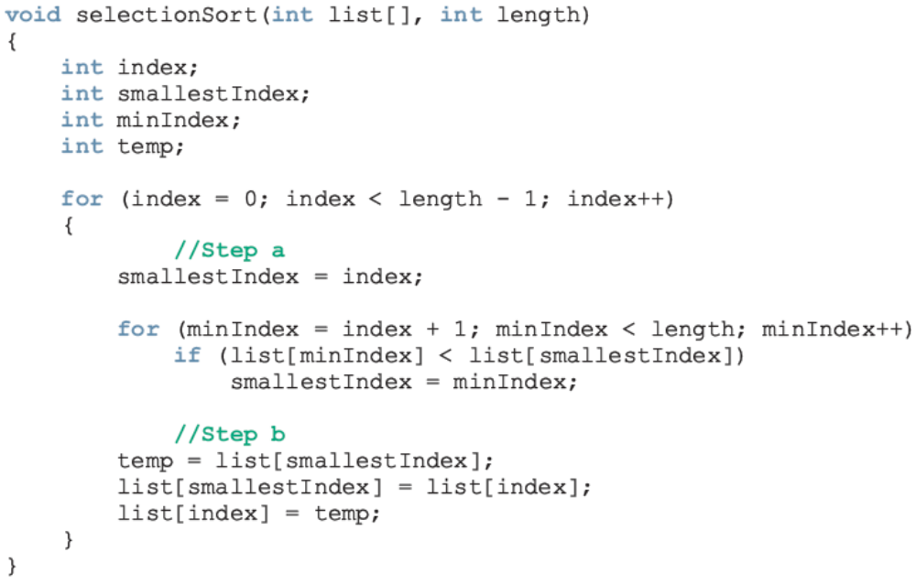
Selection Sort (continued)
C++ Programming: From Problem Analysis to Program Design, Fourth Edition

Slide 14
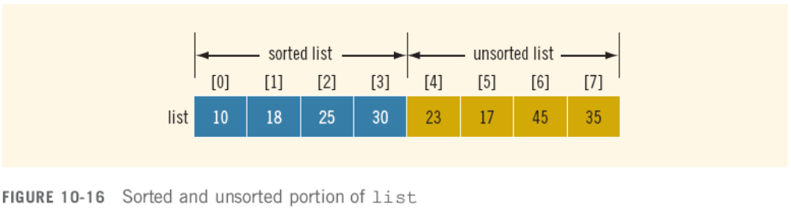
Insertion Sort
The insertion sort algorithm sorts the list by moving each element to its proper place
C++ Programming: From Problem Analysis to Program Design, Fourth Edition

Slide 15
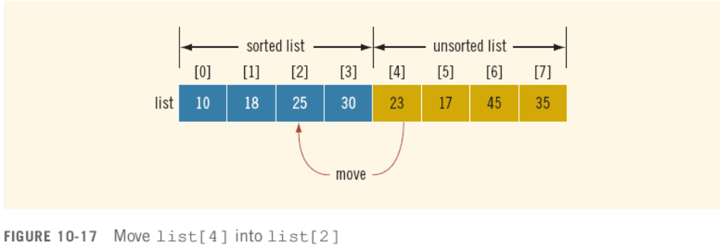
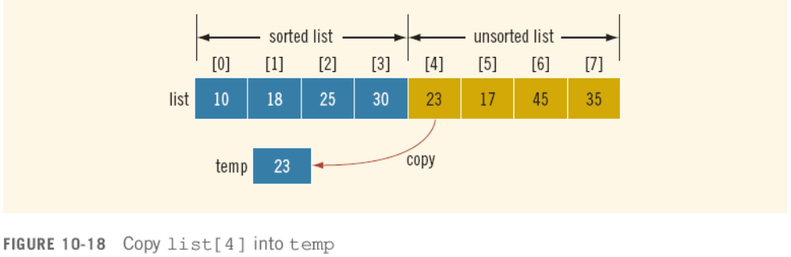
Insertion Sort (continued)
C++ Programming: From Problem Analysis to Program Design, Fourth Edition

Slide 16
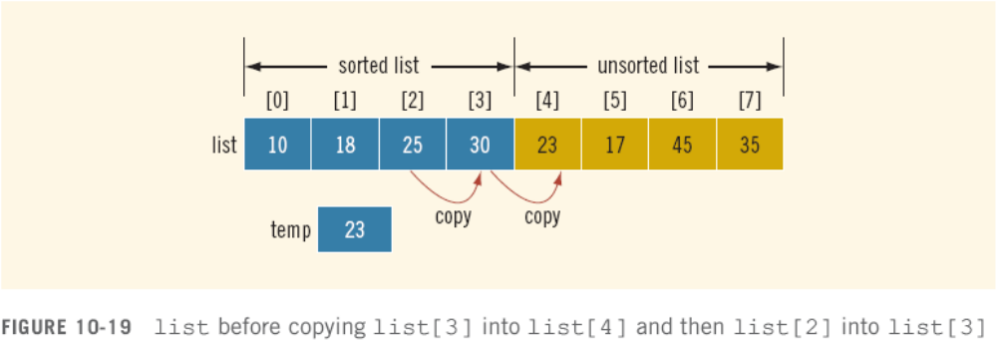
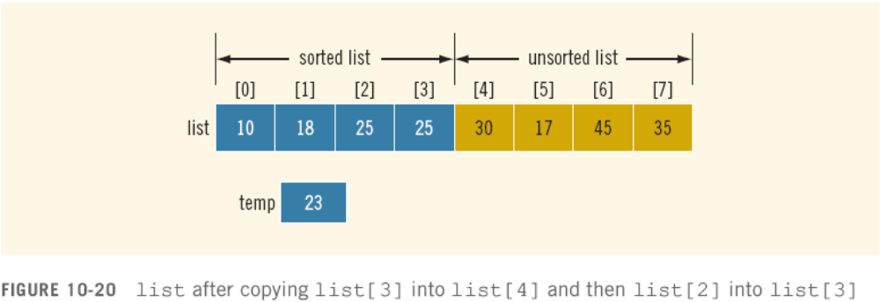
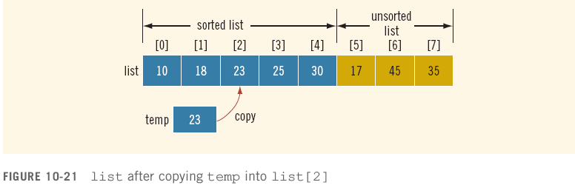

Slide 17
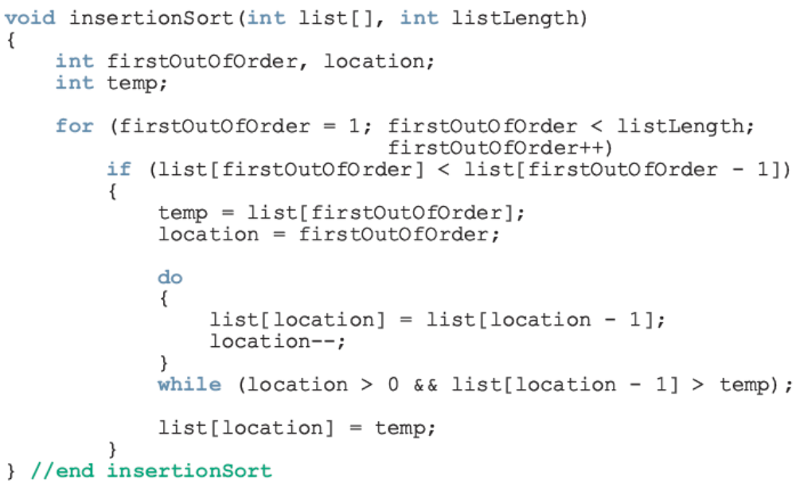
Insertion Sort (continued)
Average key comparisons: (n² + 3n – 4)/4
C++ Programming: From Problem Analysis to Program Design, Fourth Edition

Slide 18
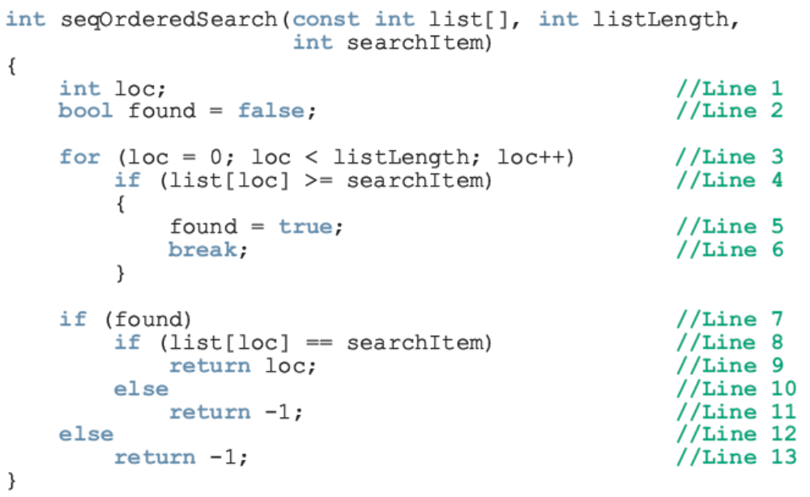
Sequential Search on an Ordered List
On average, searches half the list
C++ Programming: From Problem Analysis to Program Design, Fourth Edition

Slide 19
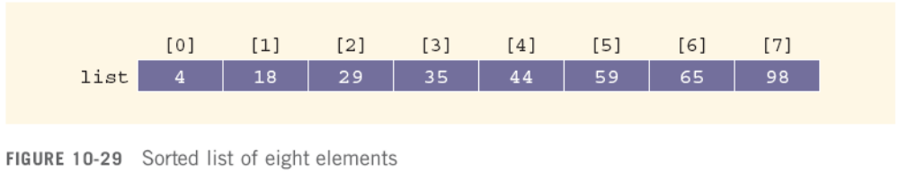

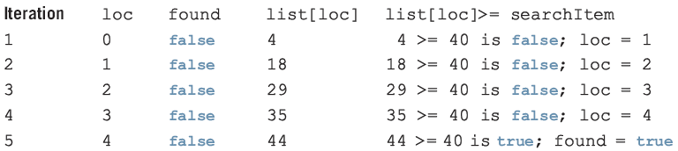

Sequential Search on an Ordered List (continued)
Search was unsuccessful
C++ Programming: From Problem Analysis to Program Design, Fourth Edition

Slide 20
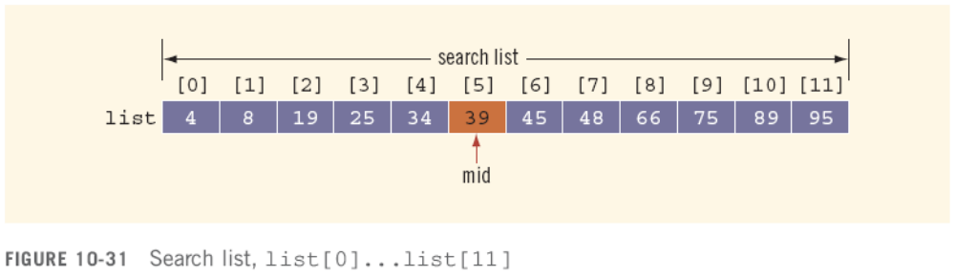
Binary Search
Binary search can be applied to sorted lists
Uses the “divide and conquer” technique
  Compare search item to middle element
  If search item is less than middle element, restrict the search to the lower half of the list
  Otherwise search the upper half of the list
C++ Programming: From Problem Analysis to Program Design, Fourth Edition

Slide 21
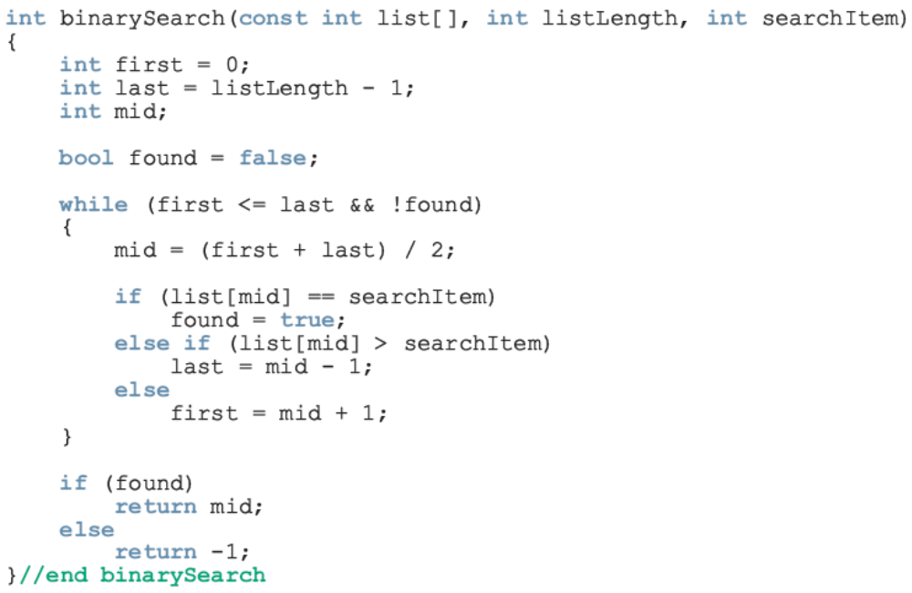

Binary Search (continued)
C++ Programming: From Problem Analysis to Program Design, Fourth Edition

Slide 22
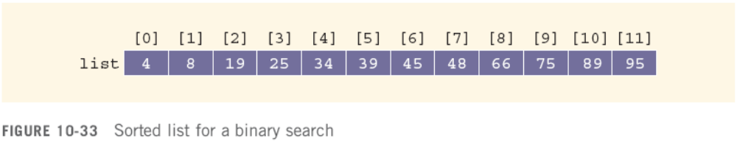

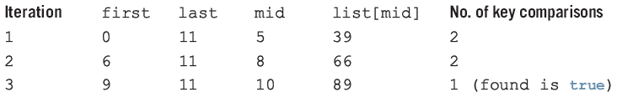
Binary Search (continued)
C++ Programming: From Problem Analysis to Program Design, Fourth Edition

Slide 23

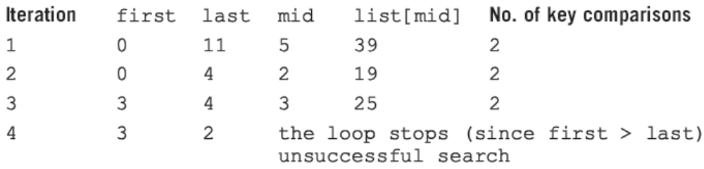
Binary Search (continued)
C++ Programming: From Problem Analysis to Program Design, Fourth Edition

Slide 24
Performance of Binary Search
Every iteration cuts size of search list in half
If list L has 1000 items
  At most 11 iterations are needed to search for x
Every iteration makes two key comparisons
  Binary search makes at most 22 key comparisons to determine if x is in L
Sequential search makes 500 key comparisons (average) to determine if x is in L for the same size list
C++ Programming: From Problem Analysis to Program Design, Fourth Edition

Slide 25
vector Type (class)
C++ provides vector type to implement a list
Variables declared with vector type are called:
  Vector container
  Vector
  Vector object
  Object
Unlike arrays, vector size can increase and decrease during execution
C++ Programming: From Problem Analysis to Program Design, Fourth Edition

Slide 26
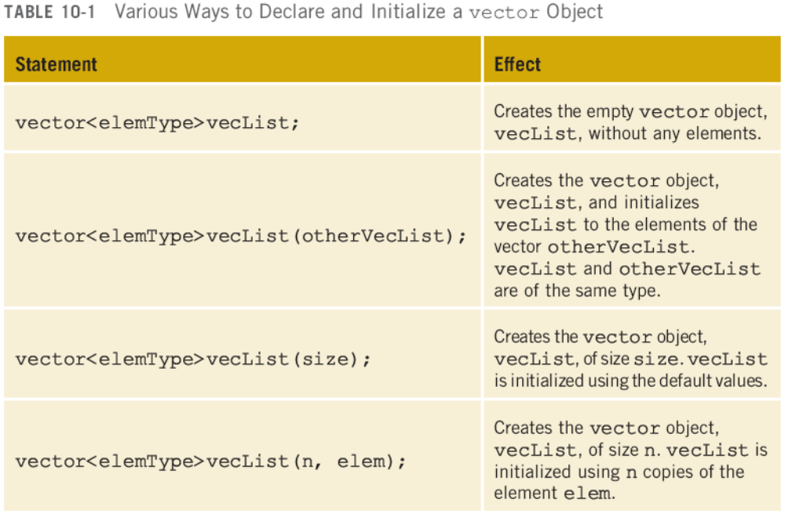
vector Type (class) (continued)
C++ Programming: From Problem Analysis to Program Design, Fourth Edition

Slide 27
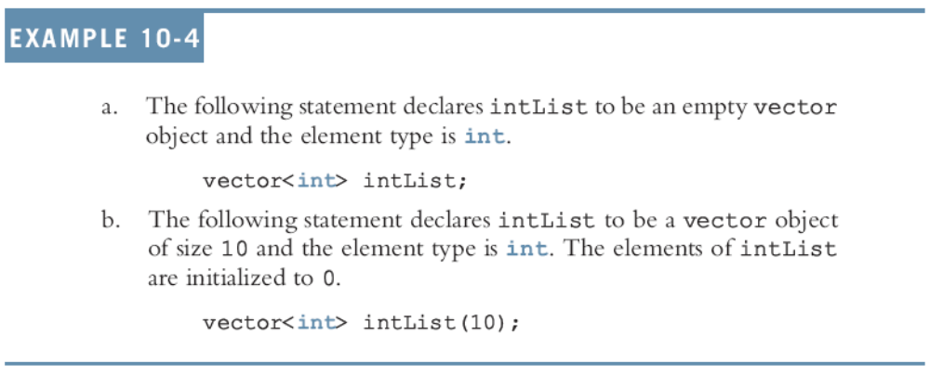
vector Type (class) (continued)
C++ Programming: From Problem Analysis to Program Design, Fourth Edition

Slide 28
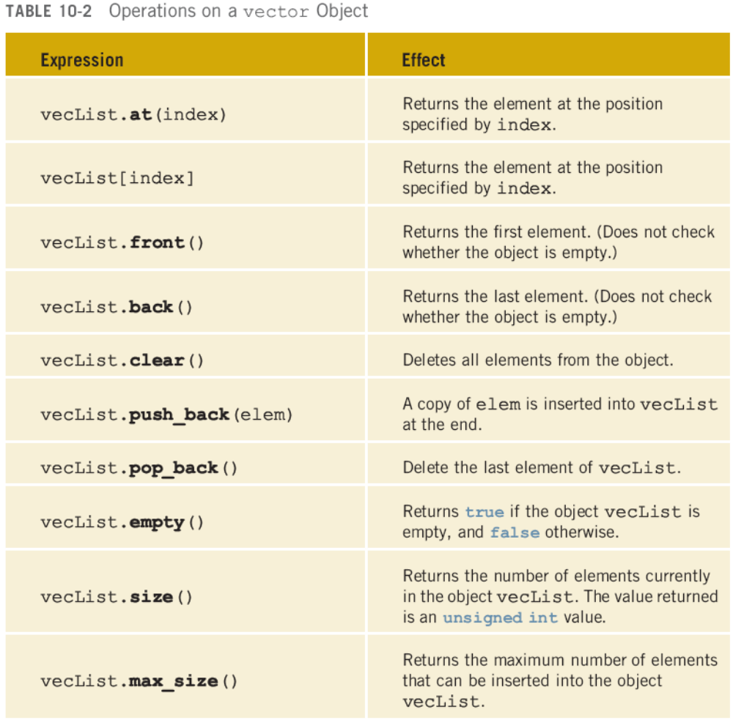

Slide 29
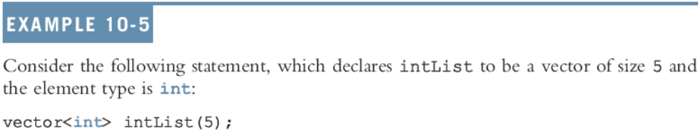
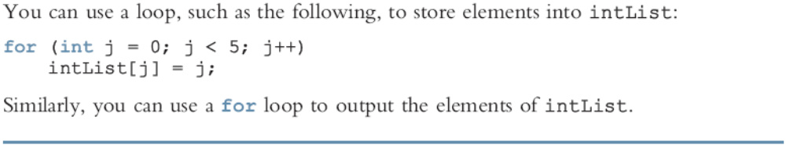
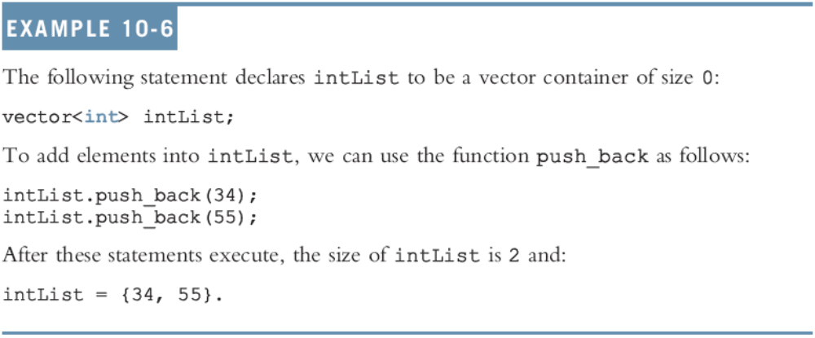

Slide 30
Programming Example: Election Results
Student council of your local university will hold presidential election soon
For reasons of confidentiality, election committee wants to computerize the voting
The committee needs a program to analyze the data and report the winner
The university has four major divisions and each division has several departments
C++ Programming: From Problem Analysis to Program Design, Fourth Edition

Slide 31
Programming Example: Election Results (continued)
For the purpose of the election, the divisions are labeled as Region 1 - Region 4
Each department in each division manages its own voting process and directly reports the votes to the election committee
The voting is reported in the following form:
  candidateName
  regionNumber
  numberOfVotesForTheCandidate
C++ Programming: From Problem Analysis to Program Design, Fourth Edition

Slide 32
Programming Example: Election Results (continued)
The data are provided in two files
  One file has candidate names seeking the president’s post (unordered)
  Each line of second file consists of voting results in the following form:
candidateName regionNumber numberOfVotesForThisCandidate
C++ Programming: From Problem Analysis to Program Design, Fourth Edition

Slide 33
Programming Example: Input and Output
For example, assume the input file looks like:
Mia 2 34
Mickey 1 56
Donald 2 56
Mia 1 78
Danny 4 29
Ashley 4 78
First line indicates that Mia received 34 votes from Region 2
Output consists of election results in tabular form as described and identifies the winner
C++ Programming: From Problem Analysis to Program Design, Fourth Edition

Slide 34
Programming Example: Problem Analysis
Program must organize voting data by region
Calculate total number of votes received by each candidate and total votes cast
Candidate names must be alphabetized
Data types
  Candidate name: string
  Number of votes: int
C++ Programming: From Problem Analysis to Program Design, Fourth Edition

Slide 35
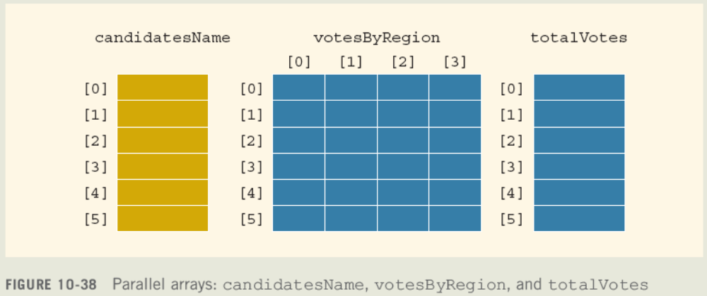
Programming Example: Problem Analysis (continued)
Need three parallel arrays
C++ Programming: From Problem Analysis to Program Design, Fourth Edition

Slide 36
Programming Example: Algorithm Design
Read candidate names into the array candidatesName
Sort candidatesName
Initialize votesByRegion and totalVotes
Process the voting data
Calculate total votes received by each candidate
Output the results
C++ Programming: From Problem Analysis to Program Design, Fourth Edition

Slide 37
Programming Example: Process Voting Data
For each entry in voteDat.txt:
  Get a candidateName, regionNumber, numberOfVotesForTheCandidate
  Find the row number in candidatesName corresponding to this candidate
    This gives the corresponding row number in the array votesByRegion for this candidate
C++ Programming: From Problem Analysis to Program Design, Fourth Edition

Slide 38
Programming Example: Process Voting Data (continued)
For each entry in voteDat.txt (continued):
  Find the column in votesByRegion corresponding to the regionNumber
  Update the appropriate entry in votesByRegion by adding numberOfVotesForTheCandidate
C++ Programming: From Problem Analysis to Program Design, Fourth Edition

Slide 39
Programming Example: Function printResults
Initialize sumVotes, largestVotes, winLoc to 0
For each row in each array
if (largestVotes < tVotes[i])
{
largestVotes = tVotes[i];
winLoc = i;
}
  sumVotes = sumVotes + tVotes[i];
Output from corresponding rows of arrays
Output the final lines of output
C++ Programming: From Problem Analysis to Program Design, Fourth Edition

Slide 40
Main Algorithm: Function main
Declare the variables
Open the input file candDat.txt
If input file does not exist, exit program
Read data from candDat.txt into the array candidatesName
Sort the array candidatesName
Close candDat.txt
C++ Programming: From Problem Analysis to Program Design, Fourth Edition

Slide 41
Main Algorithm: Function main (continued)
Open the input file voteDat.txt
If input file does not exist, exit program
Initialize votesByRegion and totalVotes
Process voting data and store results in votesByRegion
Calculate total votes received by each candidate and store results in totalVotes
Print the heading
Print the results
C++ Programming: From Problem Analysis to Program Design, Fourth Edition

Slide 42
Summary
List: set of elements of the same type
List length: number of elements
Sequential search algorithm:
  Search for an item, starting at first element
  Compare search item with other elements
  Stop when item is found, or list has no more elements left to be compared
Searches half the list (average)
Good only for very short lists
C++ Programming: From Problem Analysis to Program Design, Fourth Edition

Slide 43
Summary (continued)
Bubble sort sorts by moving the largest elements toward the bottom
Selection sort sorts by finding the smallest (or largest) element and moving it to the beginning (end) of the list
Binary search is much faster than sequential search, but requires an ordered list
C++ Programming: From Problem Analysis to Program Design, Fourth Edition

Slide 44
Summary (continued)
C++ provides vector type to implement lists
Vector size can increase or decrease
Vector object must specify the type of element the vector object stores
First element in vector is at location 0
Vector class includes various functions
C++ Programming: From Problem Analysis to Program Design, Fourth Edition

